Slide 1


Slide 2

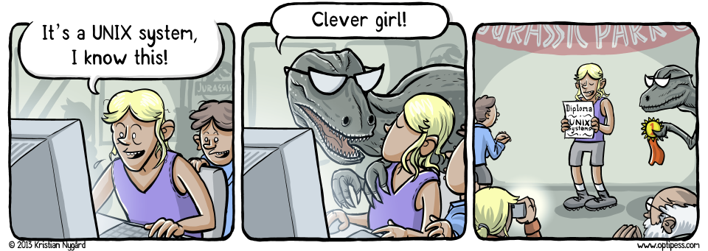
Files and Directories
Winter 2022
CS2211b - 2022

Slide 3
File and Directory Types
What is a file?
A container for data
Persistent (stays around)
Accessible by a name
In Unix, EVERYTHING is a file
Files and Directories

Slide 4
File and Directory Types
Unix file types (https://en.wikipedia.org/wiki/Unix_file_types)
Regular
Directory
Device
Link
Others
Files and Directories

Slide 5
File and Directory Types
Behind the scenes, the name in a directory is translated to a specific location on disk (disk # → cylinder # → track # → sector # → block #). This is known as an "inode number" (index node number).
This is why it is called a "directory" instead of a "folder". The directory contains an index of files (like the index in a book). The files do not physically "live" inside a folder.
Files and Directories

Slide 6
File and Directory Types
Regular file
Text file – Contain "printable" characters
Binary file – Contain any ASCII characters from 0 to 255
Files and Directories

Slide 7
File and Directory Types
Directory ("file")
Contains the names and inode numbers for all files and directories in this directory
We treat it like a folder
Files and Directories

Slide 8
File and Directory Types
Device file
Allows I/O from a device (e.g. Soundcard, mouse, etc.)
Links
Hard links
Soft links
Like a shortcut
Files and Directories

Slide 9
File and Directory Types
Links (continued)
Soft links are popular and are often called "symbolic links" or "symlinks"
ln -s <target directory> <link name>
Files and Directories

Slide 10
File and Directory Types
How do you find out what type a file is? Three suggestions:
ls -F
ls -l
ls --color=auto
(or all of them: ls -F -l --color=auto)
Files and Directories

Slide 11
Pathnames and links
Unix has directories and subdirectories. When referring to a path (e.g. the cd command), you will use one of two types
Absolute path
Relative path
Files and Directories

Slide 12
Pathnames and links
Absolute path
Begins with a / (the root)
Explicitly uses the entire path from root all the way to the subdirectory
E.g. /home/wbeldman
Files and Directories

Slide 13
Pathnames and links
Relative path
Dependent on what your current working directory is. E.g.
cd tmp - means change directory to tmp inside my current working directory. This is not the same as cd /tmp
Files and Directories

Slide 14
Pathnames and links
When referring to a location in the system, your command will check in the following order
/ - The root
~ - The home directory
. – The current directory (./ to be more explicit)
.. – The parent directory (../ to be more explicit)
Otherwise try the current working directory
Files and Directories

Slide 15
Pathnames and links
E.g. If I am in /home/wbeldman, the following are all equivalent
/home/wbeldman/cs2211/readme.txt
~/cs2211/readme.txt
cs2211/readme.txt
~/cs2211/otherfolder/../readme.txt
Files and Directories

Slide 16
Pathnames and links
Another way to combine shortcuts are like this:
cd ../../../ - Go up three directories in the tree
When running a command found in the current working directory (e.g. your compiled C program), use the ./ shortcut
./myProgram
Files and Directories

Slide 17
Wildcarding
We can use special characters to represent a sequence of other characters
When using a wildcard to match multiple files, this is known as "globbing"
* – matches 0 or more characters
? – matches exactly one character
[…] – matches any one character in the list
Files and Directories

Slide 18
Wildcarding
E.g.
a*.c* matches abc.c and abra.cpp
a?.c matches ab.c, ax.c, but not abc.c
b[aei]t matches bat, bet, or bit, but not but or baet
b[!aei]t matches but but not bat, bet, bit, or baet
Files and Directories

Slide 19
Wildcarding
E.g. combining sequences
mv a*.[ch] cfiles/ – move all files beginning with a and ending in .c or .h into cfiles
ls [abc]*.? – list all files beginning with a, b, or c, followed by (possibly) anything, followed by a dot, followed by a single character
Files and Directories

Slide 20
Wildcarding
Wildcards do not traverse directories. It only matches in the current directory
E.g. csnow*c does NOT match csnow/codec
Wildcards do not match "hidden files". Hidden files are files that start with a . (dot)
E.g. "cat *profile" will not find ".bash_profile"
Files and Directories

Slide 21
Wildcarding
[…] allows a range of characters instead of explicitly listing each one
E.g. ls [a-z]* matches all files beginning with a-z
The wildcard expansion is done by your shell, NOT by the program you are running
E.g. When "ls *" is run, it is actually doing "ls file1.txt file2.txt file3.txt …"
Files and Directories

Slide 22
Wildcarding
Other advanced examples to think about
ls /bin/*[–_]*
What’s the difference between ls * and ls
mv *.bat *.bit – This does not rename all .bat files as .bit files as you might expect
Files and Directories

Slide 23
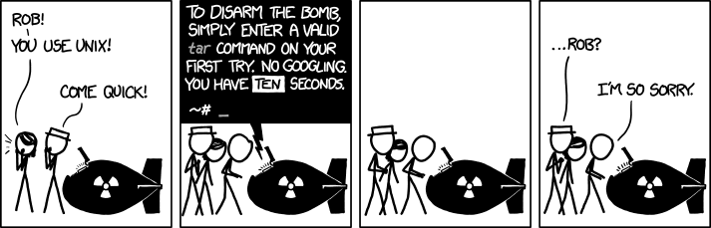
Tar
Files and Directories

Slide 24
Tar
An archiving command
Used to "bundle up" a directory and make a single file out of it, or "unpack" a file into a new directory
The resulting file by convention has a .tar extension and is called a "tarball"
Great for backups/snapshots, submitting your code in the assignments ;)
Files and Directories

Slide 25
Tar
To create a tarball out of a directory called Assignment2, use
tar cvf Assignment2.tar Assignment2
c == create, v == verbose, f == filename
To create Assignment2 out of a tarball, use
tar xvf Assignment2.tar
x == extract, v == verbose, f == filename
Files and Directories

Slide 26
Tar
You might recognize this as zipping or unzipping a directory
Technically this is not exactly the same because the tarball is not compressed/uncompressed
If you supply z as in cvzf/xvzf, this will create an archive file and compress it. By convention, we use .tar.gz as the extension
Files and Directories

Slide 27
Finding files
Use find to recursively locate files in a large directory structure
A very powerful tool that can (among many things)
Match wildcards in file names
Match based on file size, permissions, creation time, etc.
Execute commands on each file found
Files and Directories

Slide 28
Finding files
To use find, the syntax follows the format: find <path> <expression> e.g.
find ./ -name "README" – Find all files and directories under the current directory called "README"
find /usr/include -name "*.h" – Find all files and directories under /usr/include ending in .h
Files and Directories

Slide 29
Finding files
More examples
find ./ -type f -name "README" – Find all files (but not directories) under the current directory called "README"
find ./ -type d -name "README" – Find all directories (but not files) under the current directory called "README"
Files and Directories

Slide 30
Finding files
Use "man find" to read the manual and discover more options
Files and Directories

Slide 31
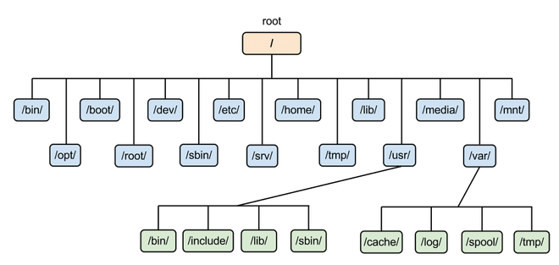
The Unix File System
A Unix filesystem is organized like an upside down tree
Files and Directories

Slide 32
The Unix File System
The top of the file system is known as the "root" directory and is identified with a single slash ( / )
This is NOT the same as a backslash ( \ ) which is commonly used in Windows
What kind of files are stored in which directory are done by convention only.
Files and Directories

Slide 33
The Unix File System
The Unix file system can transparently span multiple disks (including network attached disks).
As a regular user, you don’t actually need to know this detail, nor should you care
You can use the df command to see other disks
Files and Directories

Slide 34
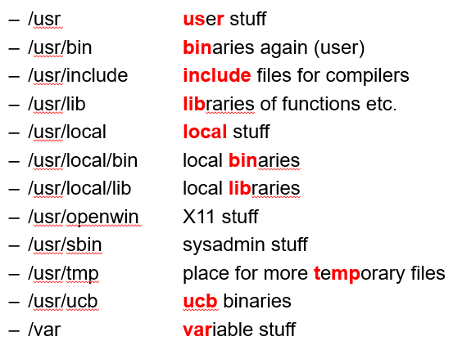
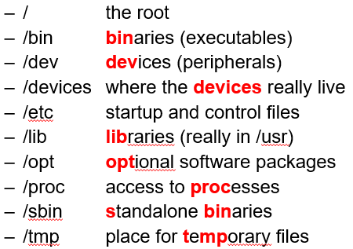
The Unix File System
Some common directories in Unix
Files and Directories

Slide 35
The Unix File System
/bin – contains small executable programs (binaries). This is where you find the common commands you are used to (e.g. ls, cd, mkdir, etc.)
/sbin – contains small executable programs (binaries) but are only used by the system administrator.
/lib (and /usr/lib) – contains binary library files that other programs might call (e.g. stdio.h)
Files and Directories

Slide 36
The Unix File System
/dev – Everything in Unix is a file – even devices. This directory contains device files (see slide 8) e.g. disk drives, input devices
/boot – The OS kernel lives here. The heart of the operating system. If the rest of the Unix system is broken, you at least need /boot to be available so the OS can boot up
Files and Directories

Slide 37
The Unix File System
/etc – Contains system configuration files (regular files). The OS and other programs typically store their configuration information in this directory
/proc – Virtual files that represent the current state of the kernel. Processes can refer to files here to retrieve information about the system or other processes
Files and Directories

Slide 38
The Unix File System
/mnt – Commonly used to hold sub-directories that are temporarily mounted. This could be something like /mnt/cdrom or /mnt/windows for dual-boot systems
/usr – Stores programs and files used by end-users. Non default stuff usually goes here. Think of this like C:\Program Files
/var – Variable data files. Typically log files
Files and Directories

Slide 39
The Unix File System
/home – Contains the home directories for any user with a login to the system (except root). A home directory is the user’s personal space
/root – The home directory of the "root" user
Files and Directories

Slide 40
The Unix File System
/tmp – Contains temporary files and directories. Accessible by everyone. Many systems periodically purge this directory so DON’T store important files here!
/opt – Some large applications will choose to bundle all their files and directories here instead of /usr, /etc, /bin, etc.
Files and Directories

Slide 41
Working with directories
We covered making and removing directories already. Let’s look at moving and copying directories
Files and Directories

Slide 42
Working with directories
A directory is just a file, so you move it the same as you would any other file:
mv <directory1> <directory2> - Moves <directory1> into <directory2>
Files and Directories

Slide 43
Working with directories
Copying is a little different. You have to explicitly tell cp that you want to copy the directory and any files below it.
Use the -r argument to copy recursively. E.g.
cp -r <directory1> <directory2> - Copy directory 1 and everything below it into directory 2
Files and Directories

Slide 44
Working with directories
pushd and popd can be used to maintain a list (a stack) of directories
pushd <directory1> - change directory to directory1 and put directory1 on top of the stack
popd - change directory to the top of the stack and remove it from the stack
The current stack is also printed for you
Files and Directories

Slide 45
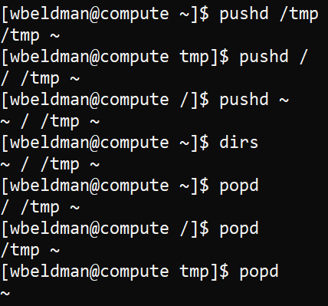
Working with directories
Use the dirs command to display the current stack
Files and Directories

Slide 46
File names
Almost any character can be in a filename except / and the "null" character
Still, don’t use these special characters: ? * [ ] " ‘ ( ) & : ; !
Don’t use these as the first character: - ~
If you do, you're gonna have a bad time!
Files and Directories

Slide 47
File names
Unix is case sensitive. Upper and lower case are different. A.txt and a.txt are different files
Unix doesn’t use extensions. a a. .a … a.b.c Are all valid filenames
Files and Directories

Slide 48
File names
Unix is case sensitive. Upper and lower case are different. A.txt and a.txt are different files
Unix doesn’t use extensions. a a. .a … a.b.c are all valid filenames
Files and Directories

Slide 49
File names
Extensions are still useful to the user so in practice they are still used. E.g.
.c means a C program
.jpg for a JPEG image file
.txt means a text file
.mp3 for a music file
Files and Directories

Slide 50
File names
Executable files do not have an extension either. Windows usually uses the .exe extension.
There are limits to the length of the name
Typically 255 characters for a file name and 4096 characters for the entire path
Files and Directories

Slide 51
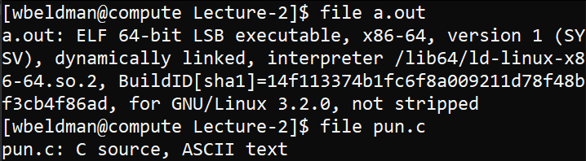
File names
Use the "file" command to gather info on a file
Files and Directories

Slide 52
File names
Files beginning with a . (dot) are "hidden" files. ls will not list them by default. You have to use "ls -a"
You have a bunch of these in your home directory already. These typically hold personal configuration files rather than storing them in /etc for all to see
Files and Directories

Slide 53
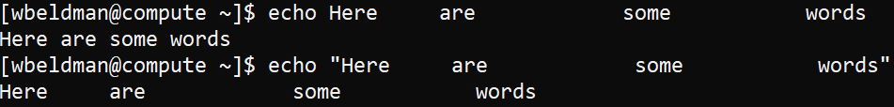
Unix Quoting
Use quotations marks to stop the shell from interpreting special characters (e.g. whitespace, *, or ~)
Here’s an example with "
Files and Directories

Slide 54
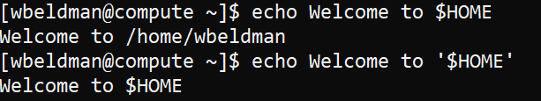
Unix Quoting
Here’s an example with ‘
Files and Directories

Slide 55
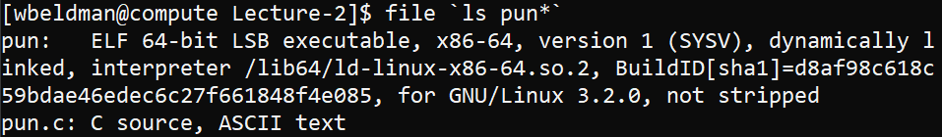
Unix Quoting
You can use ` (backtick) to "insert the results of a command". E.g.
Note that a backtick (`) and single quote (‘) are not the same!
Files and Directories

Slide 56
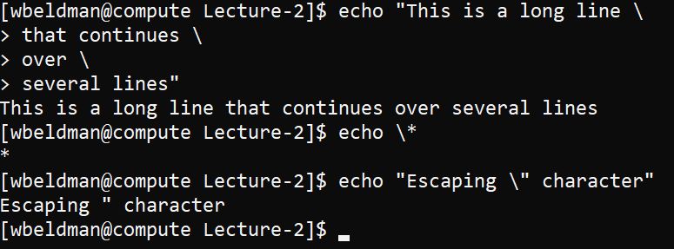
Unix Quoting
The backslash "quotes" or "escapes" the next character (like a newline or another special character). E.g.
Files and Directories

Slide 57
Miscellaneous
A few other useful commands to know
head <filename> - View the first few lines of a file
tail <filename> - View the last few lines of a file
Files and Directories

Slide 58
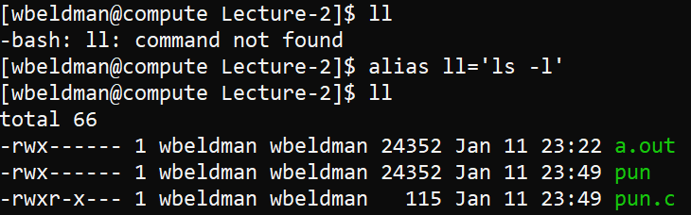
Miscellaneous
A few other useful commands to know
alias <mycommand>=<another command>
Files and Directories

Slide 59
Miscellaneous
A few other useful commands to know
which <command> - Where is a command located. The command whereis works similarly. This can help you find out if a command is installed or not.
whatis <command> - A one-liner description of <command> (This is drawn from the man page)
Files and Directories

Slide 60
Miscellaneous
A few other useful commands to know
clear – clear all the text off of the screen
history – a running history of all the commands you have run
touch <filename> - Updates the "update time" on a file. If <filename> does not exist, this is a useful way to create a new empty file
Files and Directories

Slide 61
Miscellaneous
A few other useful commands to know
echo "Some Text" – Write "Some Text" to the screen. This will be very useful when writing shell scripts
grep "Some Text" <filename> - Search for "Some Text" inside <filename>
Files and Directories

